Slide 1

Lost & Seek
Presenter:
Ranjita Rai
Srijana Lohani

Slide 2
Table Of Content
S.N | Content | Page No.
1 | Introduction | 2
2 | Problem Statement | 3
3 | Objectives | 4
4 | scope and limitations | 5
5 | Implementation Module | 6
6 | Database Design | 8
7 | Implementation Details | 9
8 | System Architecture | 10
9 | A little Sneak Peak | 11
10 | Conclusion | 12
1

Slide 3

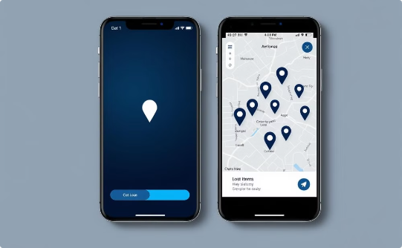

Lost & Seek: Reuniting Lost Items with Their Owners
Reunited Owners
Easy-to-use App
Accessible Platform
The joy of recovery.
Streamlined reporting.
Inclusive design for everyone.
2

Slide 4
The Problem: A Common and Frustrating Experience
Lost and Found Items
Lack of Efficient System
Losing personal belongings is a frequent occurrence, causing stress and inconvenience.
No centralized system exists to effectively reconnect lost items with their rightful owners.
3

Slide 5

Objectives: Bridging the Gap
1
Personalized Dashboard
2
Streamlined Reporting
Enable users to view reported items through a personalized dashboard.
Allow users to report and check lost and found items through a web-based platform.
3
Searchable Database
Provide a searchable database of lost and found items to expedite the recovery process.
4

Slide 6
Scope and Limitations: Defining Our Focus
Scope
Limitations
Allow users to register and create profiles to report both lost and found items. Include features like item reporting, search functionality, and notification systems.
User authentication issues and forgotten passwords can hinder account access and user engagement.
5

Slide 7

Implementation Module: User Perspective
Login/Signup
Dashboard
Authenticate using credentials or Google account; create an account to report lost and found items.
Personalized page for viewing reported items, managing notifications, and tracking progress.
Submit/Search
Logout
Submit detailed information about lost or found items; search the database for matching items.
Ends the session and redirects to the homepage.
6

Slide 8





Implementation Module: Admin Control
Login
Item Management
Admin credentials authenticate access to the admin panel for managing the platform.
Admin manages item operations, creating, deleting, and updating item records.
Dashboard
Match Confirmation
Personalized page for viewing statistics, user activity, and managing platform functionality.
Admin confirms matching items based on reported details and user verification.
7

Slide 9





Database Design: Building the Foundation
lost_and_found
1
Main database housing all platform data.
Users
2
Stores user and admin details: id, username, email, password.
Items
3
Stores item details: id, user id, name, description of lost or found items.
Notifications
4
Stores notifications with item id, user id, and message content.
Matched_items
5
Stores lost and found item ids, admin id, and match status.
8

Slide 10
Implementation Details: Building the Platform
Tools
1
VS Code for coding, Draw.io for diagrams, GitHub for version control.
Programming Languages
2
HTML, CSS, and JavaScript for front-end; PHP for back-end; MySQL for database.
9

Slide 11

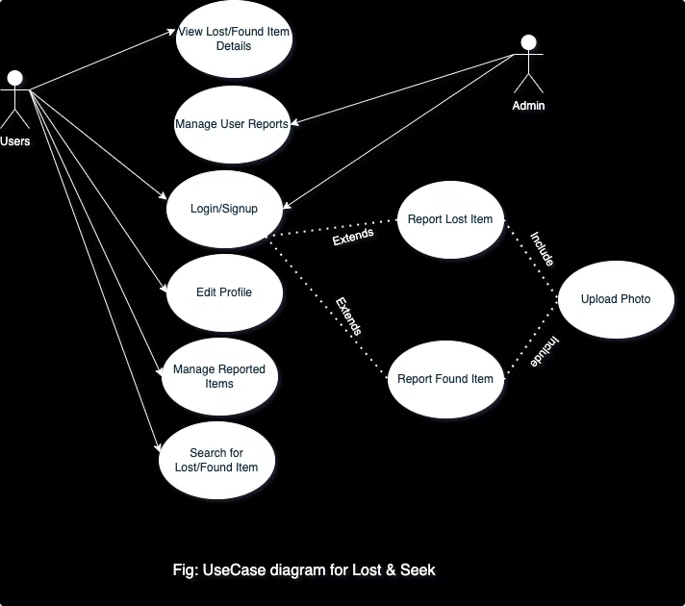
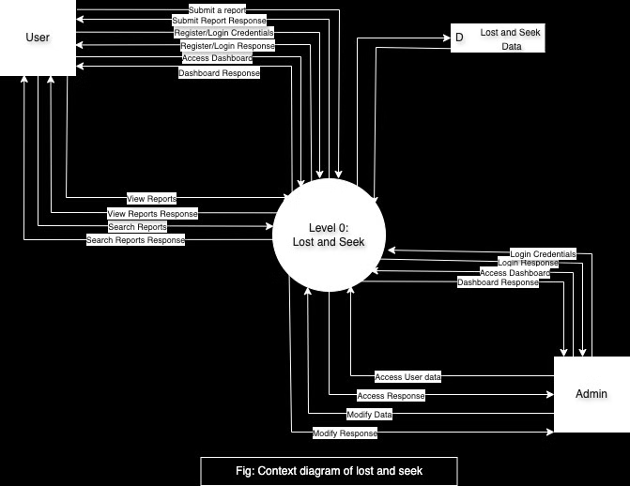
System Architecture: Visualizing the Flow
The images provide a visual representation of the Lost & Seek system's architecture, showing the interaction between users, the database, and the admin interface.
10

Slide 12
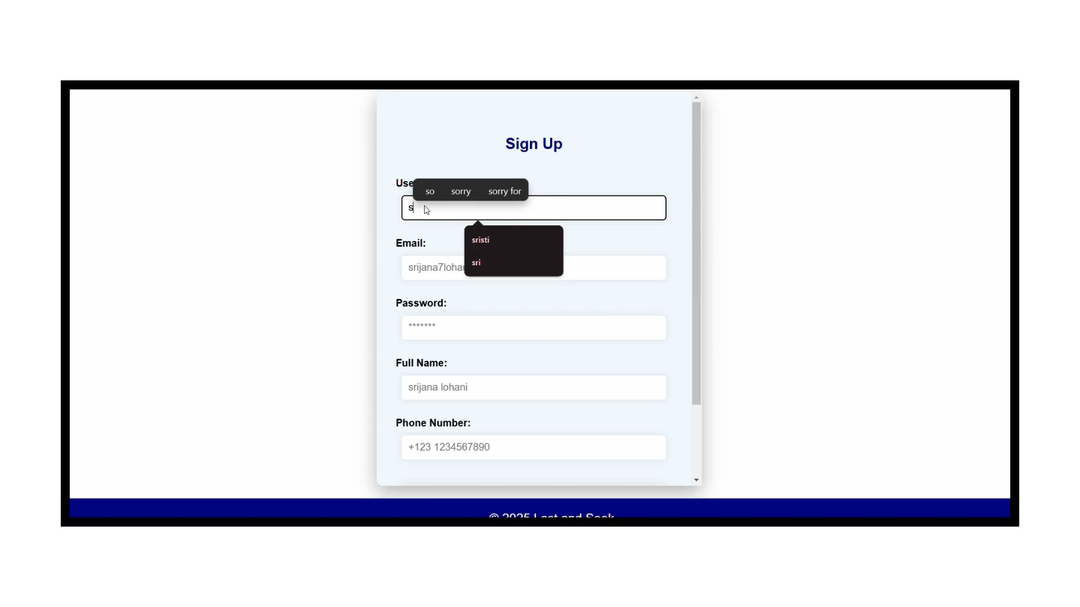
A Little Sneak Peak
11

Slide 13

Conclusion: Lessons Learned and Future Directions
1
2
Technical Expertise
AI Integration
Developed expertise in web development using JavaScript, HTML, CSS, PHP, and MySQL.
Consider integrating AI for image recognition and automated matching of lost and found items.
3
4
Market Expansion
App Development
Explore expanding the platform's reach to new regions and communities.
Develop a mobile app for enhanced user experience and wider accessibility.
12

Slide 14
Thank You ☺

